Slide 1
Tidyverse
Introduction to Computational CMB
Meg Hemmerlein
14 February 2024

Slide 2
Agenda
Monday
Wednesday
Dataframes
Dplyr & tidyr
Factors
Renaming
Converting
Homework 1
Homework 2

Slide 3
Wednesday Objectives
Learn about dplyr and tidyr
Learn about ’pipe’ operator %>%
Manipulate data using dplyr -- select, mutate, summarize, group_by, count
Learn about wide vs long table format
Manipulate data using tidyr -- reshape a data frame from long to wide and back using pivot_wider and pivot_longer

Slide 4
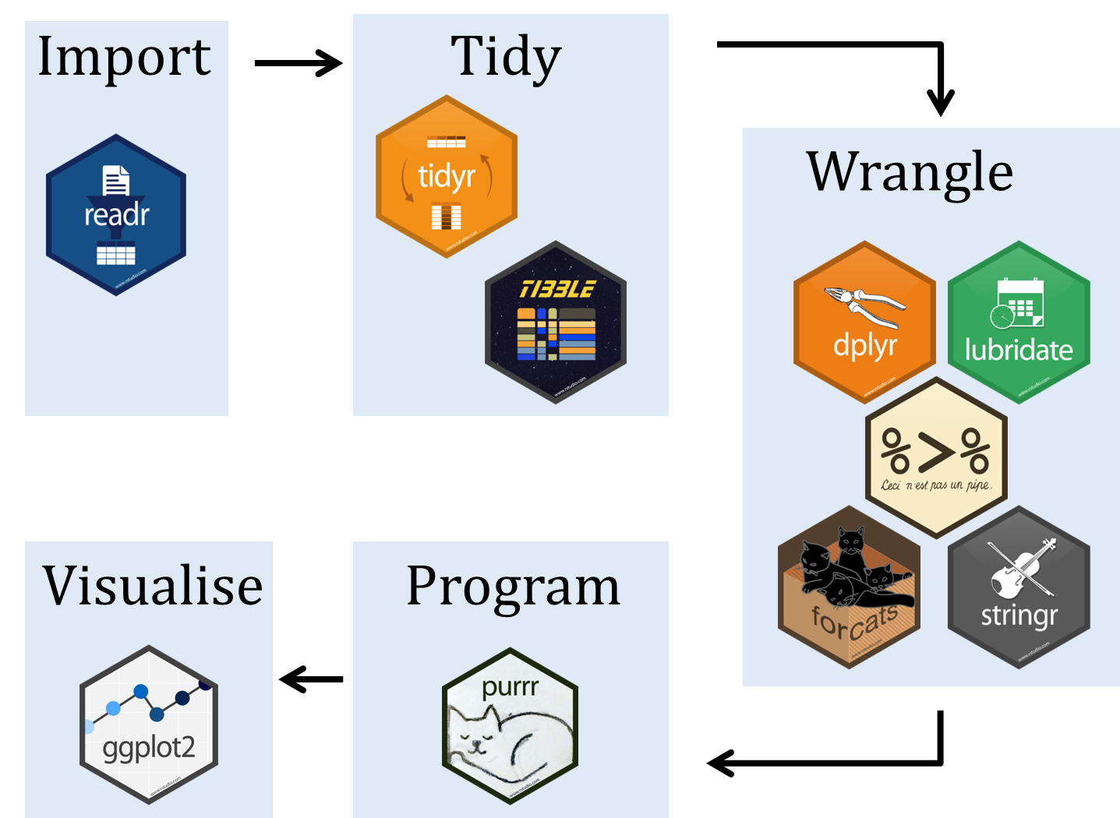

What is tidyverse?

Slide 5
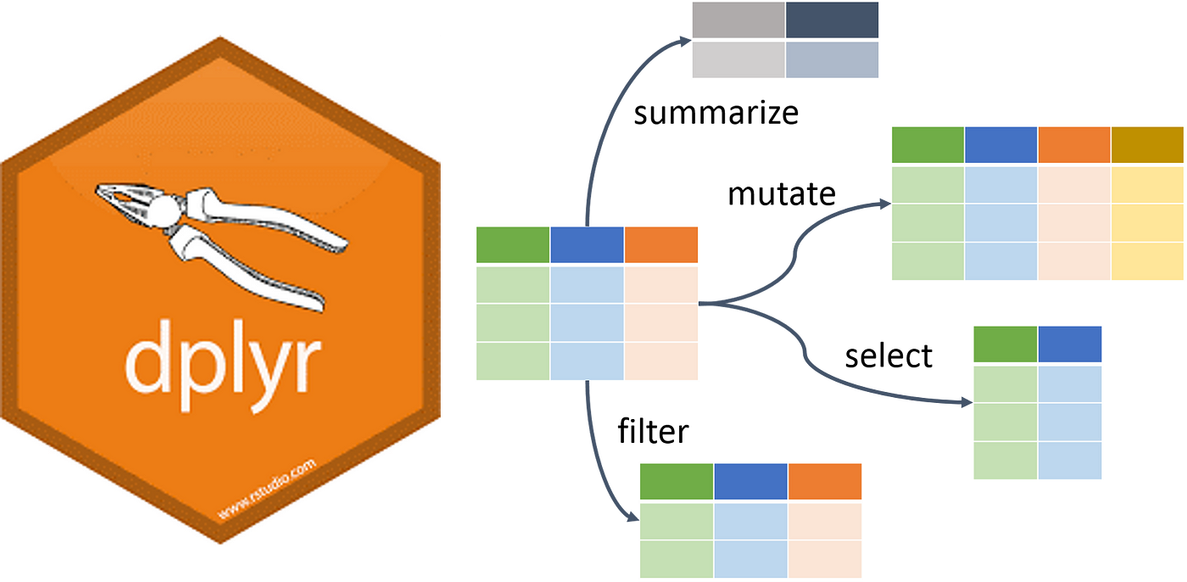
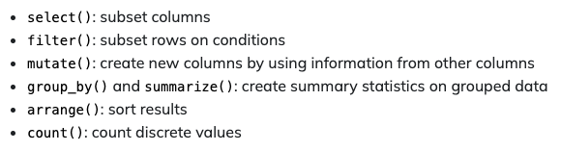
What is dplyr?

Slide 6

What is tidyr?

Slide 7
Dplyr: Selecting columns
Selecting columns of a data frame
Format: select(df, col1, col2)
Example
select(surveys, plot_id, species_id, weight)
Selecting all columns except certain ones
Format: select(df, -col1, -col2)
Example
select(surveys, -plot_id, -species_id, weight)

Slide 8
Dplyr: Filtering rows
Filtering rows
Format: filter(df, col1 == x)
Example
filter(surveys, year == 1995)

Slide 9
Run chunk 0-5

Slide 10
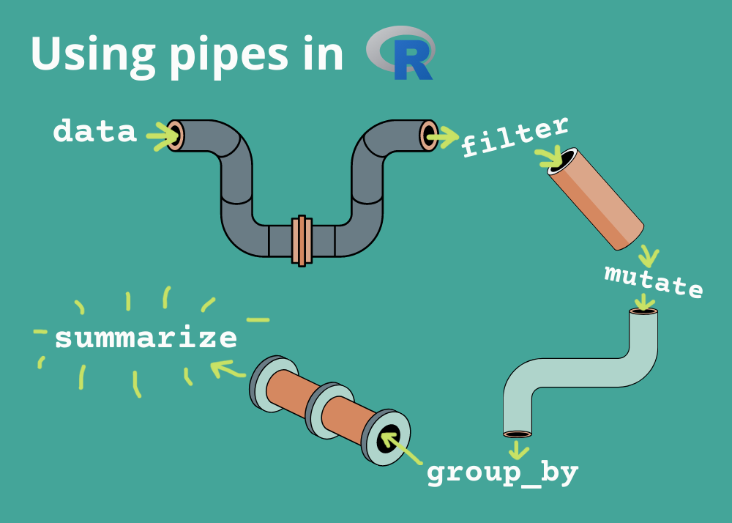
What are pipes? %>%
With dplyr we can perform a series of operations using pipes
Pipes will send the results of one function into another using the pipe operator (%>%)
One line of code is now equivalent to multiple

Slide 11

Dplyr: Pipes
Selecting and filtering
surveys %>%
filter(weight < 5) %>%
select(species_id, sex, weight)
Piping shortcut!

Slide 12
Dplyr: Pipes (Example 1)
We can use pipes to avoid generating new objects over and over.
Step 1: Filtering for weight < 5
Step 2: Selecting for species id, sex and weight columns
Stepwise:
surveys2 <- filter(surveys, weight < 5)
surveys_sml <- select(surveys2, species_id, sex, weight)

Slide 13
Run chunk 0-5

Slide 14
Dplyr: Pipes (Example 1)
We can use pipes to avoid generating new objects over and over.
Step 1: Filtering for weight < 5
Step 2: Selecting for species id, sex and weight columns
Stepwise:
surveys2 <- filter(surveys, weight < 5)
surveys_sml <- select(surveys2, species_id, sex, weight)
Using pipes:
surveys %>%
filter(weight < 5) %>%
select(species_id, sex, weight)

Slide 15
Run chunk 9

Slide 16
Dplyr: Pipes (Example 2)
We can use pipes to avoid generating new objects over and over.
Step 1: Filtering for surveys and weight
Step 2: Selecting for sex, genus and species columns
Stepwise:
surveys2 <- filter(surveys, genus == "Peromyscus", species == "maniculatus")
surveys_sml <- select(surveys2, sex, genus, species)

Slide 17
Run chunk 10-12

Slide 18
Dplyr: Pipes (Example 2)
We can use pipes to avoid generating new objects over and over.
Step 1: Filtering for surveys and weight
Step 2: Selecting for sex, genus and species columns
Stepwise:
surveys2 <- filter(surveys, genus == "Peromyscus", species == "maniculatus")
surveys_sml <- select(surveys2, sex, genus, species)
Using pipes:
surveys %>%
filter(genus == "Peromyscus", species == "maniculatus")%>%
select(sex, genus, species)

Slide 19
Write out code in chunk 13

Slide 20
Dplyr: Pipes
Piping into new object
surveys_sml <- surveys %>%
filter(weight < 5) %>%
select(species_id, sex, weight)

Slide 21
Run chunk 14-15

Slide 22
Dplyr: Mutate
Creating new columns based on existing columns (for example, unit conversion or find the ratio between two columns)
To create a new column of weight in kg:
surveys %>%
mutate(weight_kg = weight / 1000)
To create a second column based off first new column:
surveys %>%
mutate(weight_kg – weight / 1000,
weight_lb = weight_kg * 2.2)

Slide 23
Dplyr: Mutate (No NAs)
To create a new column of weight in kg and view head:
surveys %>%
mutate(weight_kg = weight / 1000)
head()
The first few rows of the output have NAs in weight column, to remove those we could insert a filter in the chain:
surveys %>%
filter(!is.na(weight))%>%
mutate(weight_kg = weight / 1000)
head()

Slide 24
Run chunk 16-19

Slide 25
Dplyr: Group_by and summarize
Split-apply-combine paradigm: split the data into groups, apply some analysis to each group, and then combine the results
Group_by() is often used together with summarize(), which collapses each group into a single row summary of that group.

Slide 26
Dplyr: Group_by and summarize
Split-apply-combine paradigm: split the data into groups, apply some analysis to each group, and then combine the results
Group_by() is often used together with summarize(), which collapses each group into a single row summary of that group.
Step 1: Grouping by sex
Step 2: Summarizing mean weight (removing NAs)
Stepwise:
surveys2 <- group_by(surveys, sex)
surveys_sml <- summarize(mean_weight = mean(weight, na.rm = TRUE))

Slide 27
Run chunk 20-22

Slide 28
Dplyr: Group_by and summarize
Split-apply-combine paradigm: split the data into groups, apply some analysis to each group, and then combine the results
Group_by() is often used together with summarize(), which collapses each group into a single row summary of that group.
Step 1: Grouping by sex
Step 2: Summarizing mean weight (removing NAs)
Stepwise:
surveys2 <- group_by(surveys, sex)
surveys_sml <- summarize(mean_weight = mean(weight, na.rm = TRUE))
Using pipes:
surveys %>%
group_by(sex) %>%
summarize(mean_weight = mean(weight, na.rm = TRUE))

Slide 29
Run chunk 23

Slide 30
Dplyr: Group_by and summarize
Split-apply-combine paradigm: split the data into groups, apply some analysis to each group, and then combine the results
Group_by() is often used together with summarize(), which collapses each group into a single row summary of that group.
Grouping multiple columns
surveys %>%
group_by(sex, species_id) %>%
summarize(mean_weight = mean(weight, na.rm = TRUE))
tail()

Slide 31
Run chunk 24

Slide 32
Dplyr: Group_by and summarize NaN?? NA? What the heck.
The sex column contains NA values because some animals had escaped before their sex and body weights could be determined
The resulting mean_weight column does not contain NA but NaN (“Not a Number”) because mean()was called a vector of NA values while at the same time setting na.rm = TRUE.
To avoid this, we can remove the missing values for weight before we attempt to calculate the summary statistics on weight.
Because the missing values are removed first, we can omit na.rm = TRUE when computing the mean.
Let’s fix this …

Slide 33
Dplyr: Group_by and summarize Fixing NA values
Filter out NAs from weight column and then summarize (no need for na.rm = TRUE)
surveys %>%
filter(!is.na(weight)) %>%
group_by(sex, species_id) %>%
summarize(mean_weight = mean(weight))

Slide 34
Run chunk 25

Slide 35
Dplyr: Group_by and summarize Summarizing multiple variables
Summarizing multiple variables at the same time
For example, adding a column indicating minimum weight for each species of sex
surveys %>%
filter(!is.na(weight)) %>%
group_by(sex, species_id) %>%
summarize(mean_weight = mean(weight),
min_weight = min(weight))

Slide 36
Run chunk 26

Slide 37
Dplyr: Group_by and summarize Descending order
To sort a column in descending order, we need to add desc() function. For example, sorting the results by decreasing order of mean weight
surveys %>%
filter(!is.na(weight)) %>%
group_by(sex, species_id) %>%
summarize(mean_weight = mean(weight),
min_weight = min(weight)) %>%
arrange(desc(mean_weight))

Slide 38
Run chunk 27

Slide 39
Dplyr: Counting
If we want to know the number of observations found for each factor or combinations of factors, we can use count().
surveys %>%
count(sex)
To count a combination of factors
surveys %>%
count(sex, species)
To count a combination of factors AND sort output
surveys %>%
count(sex, species)%>%
arrange(species, desc(n))

Slide 40
Run chunk 28-30

Slide 41
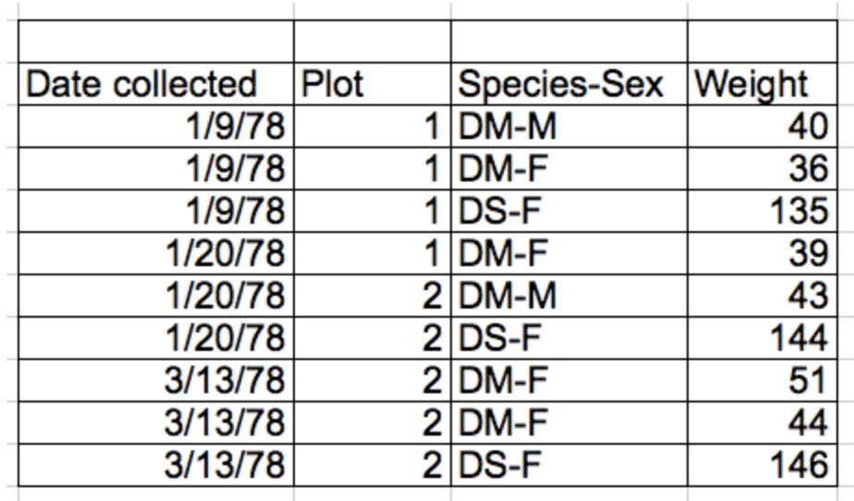
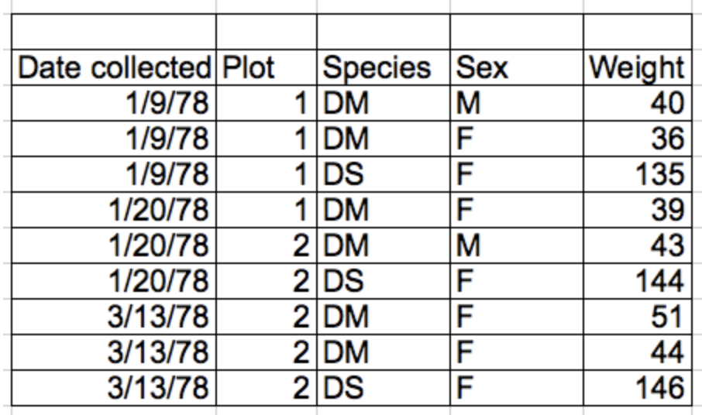
Tidy Data
Rules defining tidy data:
Each variable has its own column – thing you are measuring
Each observation has its own row
Each value must have its own cell – don’t combine data in a single cell!
Leave the raw data raw
Each type of observational unit forms a table
columns = variables, rows = observations, cells = data

Slide 42
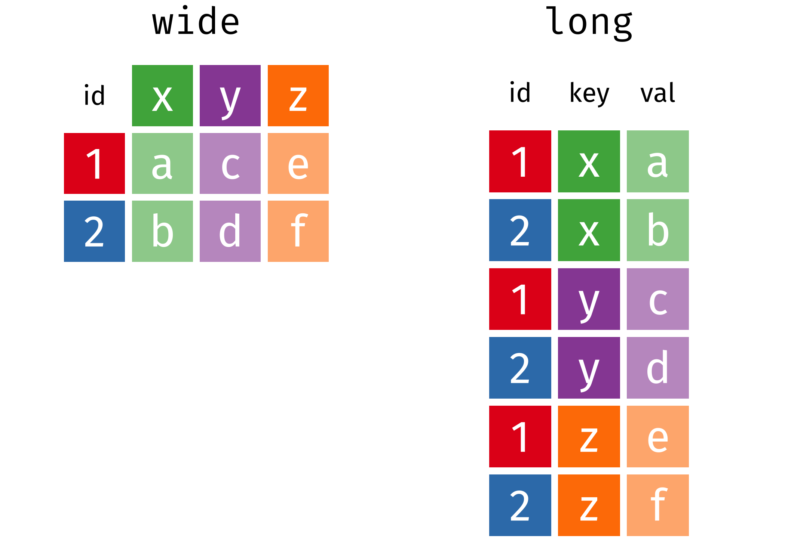
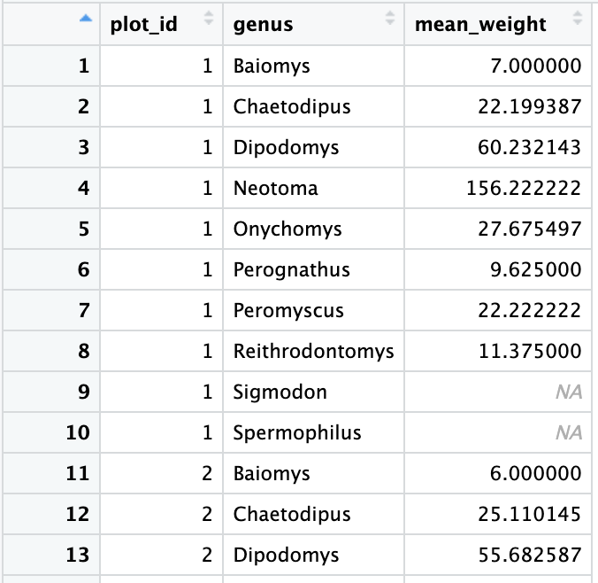
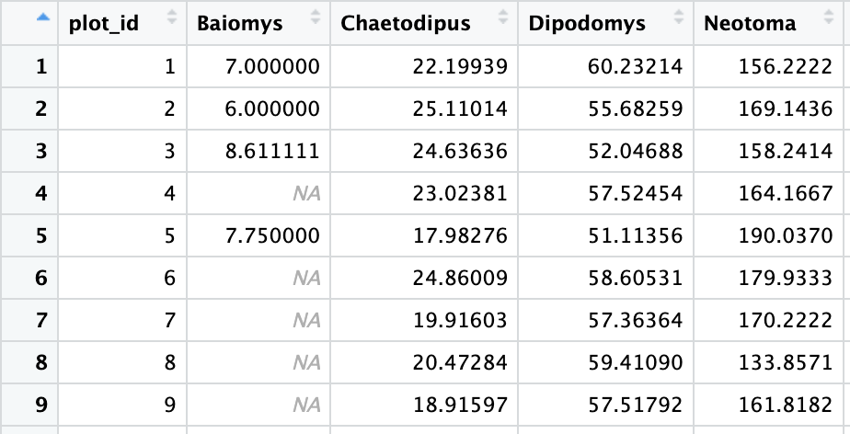
Tidyr: Wide vs. Long Format

Slide 43
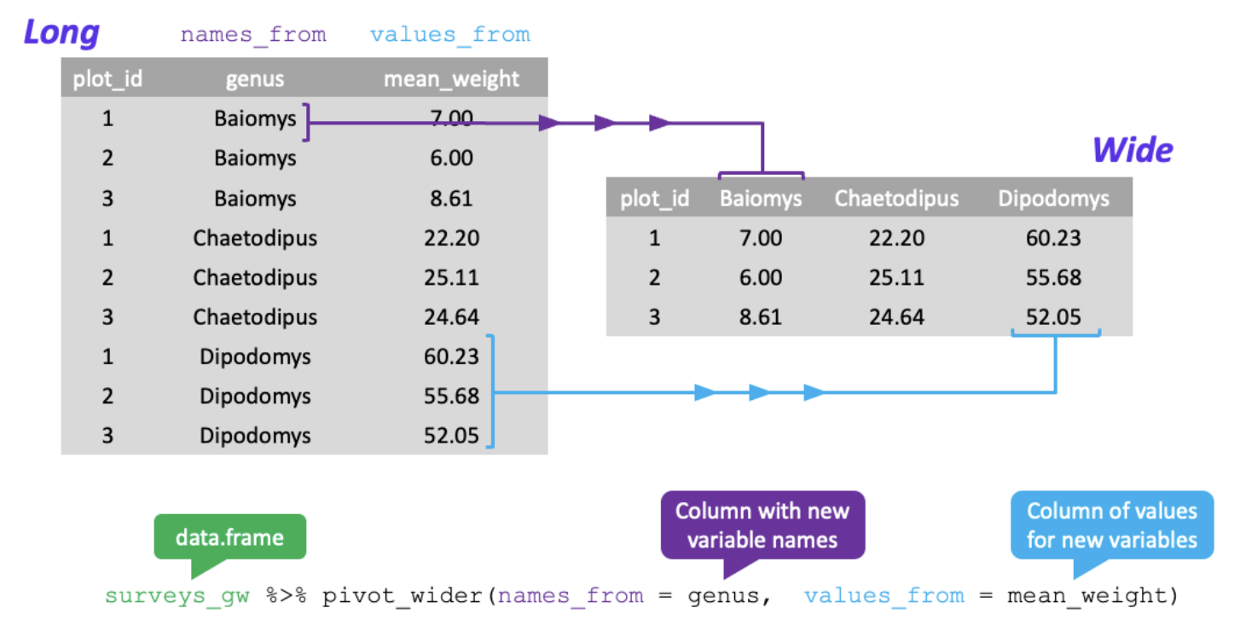
Tidyr: Pivoting from long to wide format

Slide 44
Tidyr: Pivoting from long to wide format
Firstly, filter our observations and variables of interest and create a new variable for the mean_weight
surveys_gw <- surveys %>%
filter(!is.na(weight)) %>%
group_by(plot_id, genus) %>%
summarize(mean_weight = mean(weight))
Pivoting from long to wide
surveys_wide <- surveys_gw %>%
pivot_wider(names_from = genus, values_from = mean_weight)

Slide 45
Run chunk 31-32

Slide 46
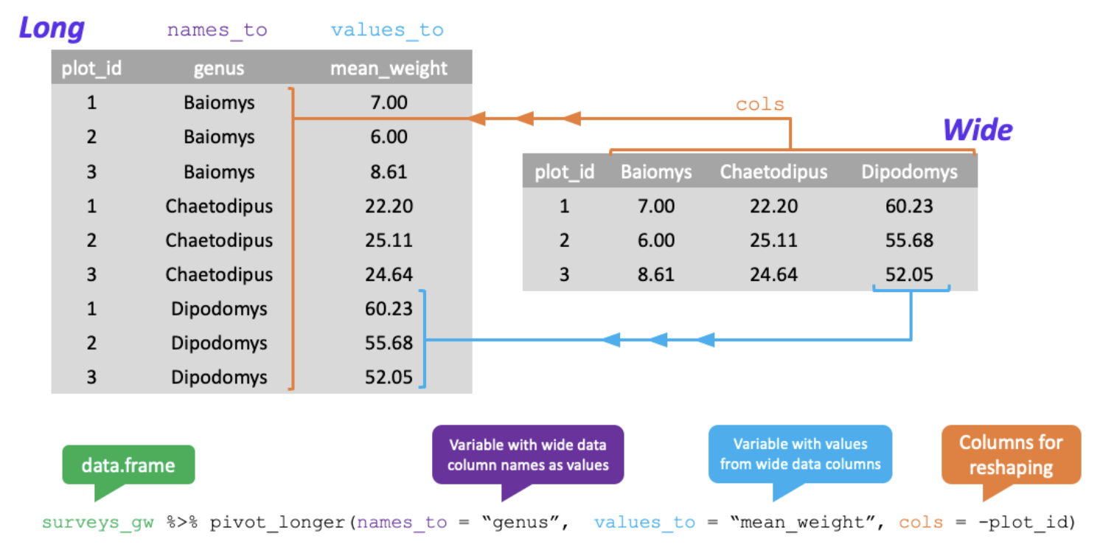
Tidyr: Pivoting from wide to long format

Slide 47
Tidyr: Pivoting from wide to long format
Pivoting from wide to long
surveys_wide <- surveys_gw %>%
pivot_longer(names_to = “genus”, values_to = “mean_weight”, cols = -plot_id)

Slide 48
Run chunk 33 Done!

